Slide 1
Ch 5.1: Review of Power Series
Finding the general solution of a linear differential equation depends on determining a fundamental set of solutions of the homogeneous equation.
So far, we have a systematic procedure for constructing fundamental solutions if equation has constant coefficients.
For a larger class of equations with variable coefficients, we must search for solutions beyond the familiar elementary functions of calculus.
The principal tool we need is the representation of a given function by a power series.
Then, similar to the undetermined coefficients method, we assume the solutions have power series representations, and then determine the coefficients so as to satisfy the equation.

Slide 2
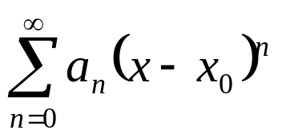
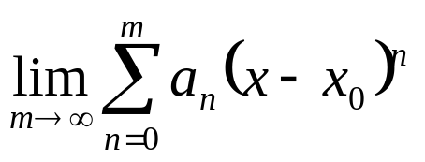
Convergent Power Series
A power series about the point x₀ has the form
and is said to converge at a point x if
exists for that x.
Note that the series converges for x = x₀. It may converge for all x, or it may converge for some values of x and not others.

Slide 3
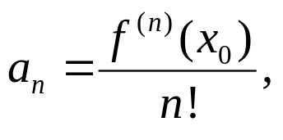
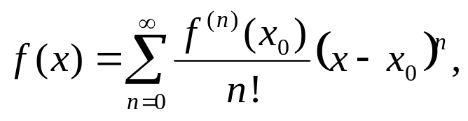
Taylor Series
Suppose that Σ a_{n}(x - x₀)^{n} converges to f (x) for |x - x₀| < ρ.
Then the value of a_{n} is given by
and the series is called the Taylor series for f about x = x₀.
Also, if
then f is continuous and has derivatives of all orders on the interval of convergence. Further, the derivatives of f can be computed by differentiating the relevant series term by term.

Slide 4
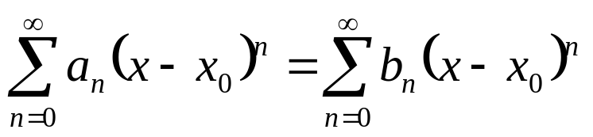
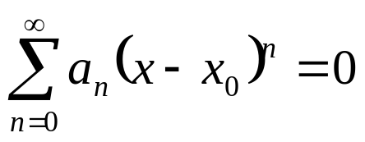
Series Equality
If two power series are equal, that is,
for each x in some open interval with center x₀, then a_{n} = b_{n} for n = 0, 1, 2, 3,…
In particular, if
then a_{n} = 0 for n = 0, 1, 2, 3,…

Slide 5
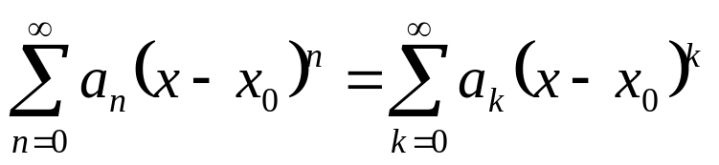
Shifting Index of Summation
The index of summation in an infinite series is a dummy parameter just as the integration variable in a definite integral is a dummy variable.
Thus it is immaterial which letter is used for the index of summation:
Just as we make changes in the variable of integration in a definite integral, we find it convenient to make changes of summation in calculating series solutions of differential equations.

Slide 6
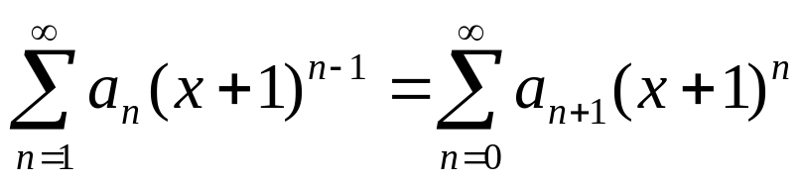
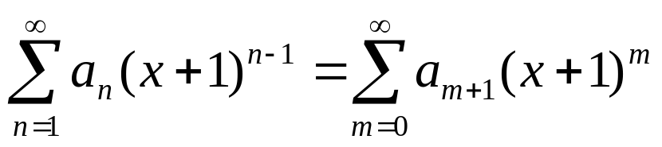
Example 4: Shifting Index of Summation
We can verify the equation
by letting m = n -1 in the left series. Then n = 1 corresponds to m = 0, and hence
Replacing the dummy index m with n, we obtain
as desired.

Slide 7
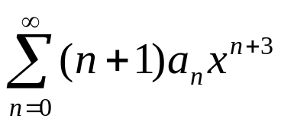
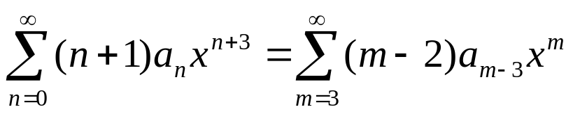
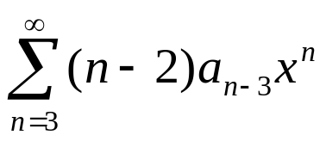
Example 5: Rewriting Generic Term
We can write the series
as a sum whose generic term involves x^{n} by letting m = n + 3.
Then n = 0 corresponds to m = 3, and n + 1 equals m – 2.
It follows that
Replacing the dummy index m with n, we obtain
as desired.

